Slide 1
JavaScript language fundamentals

Slide 2
Objectives
Validate data on the client side using Java Script,
Appreciate Ajax

Slide 3
Table of Content
JavaScript | Members that wrap HTML tags
Simple Scripts in HTML | Escape Sequence
External Script | Math
Data types and Variables | Date
Operators | Object Hierarchy
Control statements | HTML elements object events
Function | images
Calling a function | forms
Local and Global variables | Cookie
String | Components of a cookie

Slide 4
JavaScript
Is a scripting language developed by Netscape, and later standardized by W3C.
It is used
to create more interactive pages- client side validations etc.
to generate html dynamically.
To handle HTML elements events
To enhance browser capabilities by giving it a better look – printing on status bar etc.
Interaction with embedded components like applets and active x controls.
JavaScript can read an external XML file and update the data content of your web page.
Notes:
It was originally called LiveScript.
Used not only for web client and server side web programs, but also for iPhones, Adobe Photoshop, Adobe Flash action script to name a few.
JavaScript on web page works with HTML and CSS to create a DHTML page.
At this point we will focus only on HTML page client side validations.

Slide 5
Language Features
Syntax similar to C++ and Java
Case sensitive
Loosely typed
Interpreted
Platform independent
Object-based language
Semicolon, as separator for multiple statements in the same line.
Notes:
Also called prototype-based object oriented language
Object-based language
JavaScript objects are associative arrays
functions as object constructors and methods
prototypes instead of classes for inheritance.

Slide 6
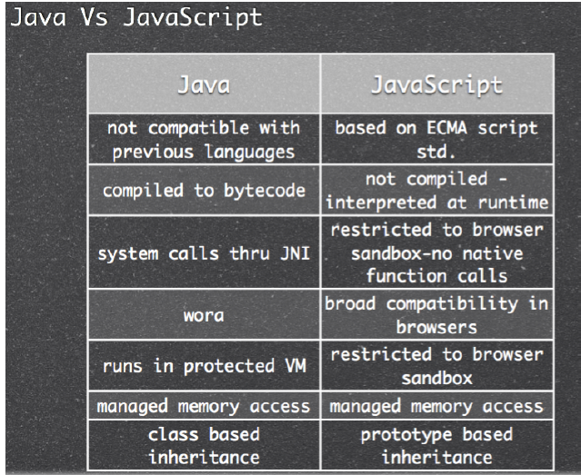
Java vs JavaScript

Slide 7
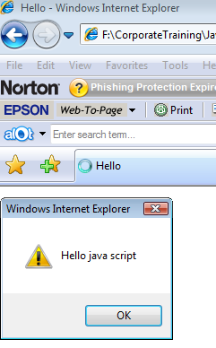
Simple Scripts in HTML
<HTML><HEAD><TITLE>Hello</TITLE></HEAD>
<BODY>
First java script code<br>
<SCRIPT type="text/javascript” >
//Java script single line comment
alert(“Hello java script”);
/* java script script
multi-line comment */
</SCRIPT>
</BODY>
</HTML>
SCRIPT tag can appear either in the HEAD or in the BODY of an HTML document
popup

Slide 8
External Script
Scripts can also be written in a separate file and can be referenced in a HTML file.
<HTML><HEAD><BODY>
<SCRIPT type="text/javascript” SRC=“jsfile.js”>
</SCRIPT>
</BODY>
</HTML>
jsfile.js
alert(“Hello”);
Path can be
Absolute path
http:://server1/get.jsp
Root relative:
/scripts/jsfile.js
Document relative
../scripts/jsfile.js
Why would you want to write JavaScript in another file?

Slide 9
Data types and Variables
Data types supported by Java Script are
Numeric – integer and floating point numbers (64 bit, IEE754 floating point)
alert(5+154e-2);
String-
alert(“Hello”) ;or
alert(‘Hello’) ;
Boolean- true, false
To declare a variable:
var x;
var x=1; →declare and initialize
Notes:
Variable names must begin with a letter, under-score or $, subsequent characters can be a letter, under-score or $ or number.
They can be assigned with proper value and used where ever appropriate . They are called data stores.
To declare a variable:
var x;
var x=1; →declare and initialize
Variables declaration is not compulsory in JavaScript. (If you don't declare a variable explicitly, JavaScript will declare it implicitly for you.)

Slide 10
Operators
Arithmetic:
+ - * / % += -= *= /= %= ++ --
Logical:
& | ! && ||
Relational:
> >= < <= == != === !==
String concatenation: +
Bit wise:
>> << >>> >>= <<= >>>=
Ternary: ?:
Conversion functions:
parseInt() and parseFloat()
To convert string to int and float respectively

Slide 11
Control statements
Same as in Java
if else
for
for..in (very much like enhanced for loop in Java)
for (variable in object) { code to be executed }
while
do .. while
switch

Slide 12
Function
Like other programming languages, in JavaScript also we can define a reusable code-block which will execute whenever it is called.
A function can be defined inside <head> , <body> or in an external file and can be called from anywhere after it has been read.
Syntax
function functionname(var1,var2,...,varX)
{
//some code
}

Slide 13
Example: writing JavaScript function
<html><head>
<script type="text/javascript”>
<!--
function display(x){
alert(x);}
-->
</script>
</head>
<body>
<script>
<!--
display(“hello”);
-->
</script>
</body></html>
display()can be defined anywhere even after the function call

Slide 14
Calling a function
The above function can be called as
display();
display(“hello”);
Or display with any number of arguments
function display(x){
if(x==null)
x=“Greetings”;
alert(x) ;
}
You can also pass values to a function that does not take any arguments!

Slide 15
Local and Global variables
All the variables that are not explicitly declared are global.
Local variables are created using var inside the function
<html><head>
<script>
total=0; //Global variable
function sum(){
y=20;
var x=10; //Local variable
total=x+y;}
function display(){
sum();
alert(total);
alert(y);
alert(x); // Error
} </script></head><body>
<script>display();</script>
</body></html>
Note that if sum() is not called then alert(y);
result in an error

Slide 16
String
Creating strings
var str=“abc”;
or var str= new String(“abc”);
String object has several members like, to get length of the string, search for a pattern etc.

Slide 17

String members
Go through these methods
Methods | Examples | Results
length | “hi”.length | 2
toLowerCase() | “Hi”.toLowerCase() | hi
toUpperCase() | “hi”.toUpperCase() | HI
indexOf(searchText [,startposition]) | “hello”.indexOf(“e”,0) or "hello".indexOf("e") | 1
lastIndexOf(searchstring[,endpos]) | "hello".lastIndexOf("l","hello".length) or "hello".lastIndexOf("l") | 3
substring(startpos, [endpos]) | “hello”.substring(1,3) | el
substr(start [,length]) | “hello”.substr(1,3) | ell
charAt(indexPos) | “hello”.charAt(4) | o
slice(startpos, [endpos]) | "hello".slice(3) or "hello".slice(3,5) | lo
0
Length of string

Slide 18
Methods | Examples | Results
charCodeAt() | ‘A’.charCodeAt() | 65
fromCharCode(n1,n2,.., nX) | String.fromCharCode(72,69,76,76,79) | HELLO
match(regexp) | "hello".match(/ll/) | ll
replace(regexp/substr,newstring) | "hello".replace(/ell/,"ipp") | hippo
search(regexp) | "hello".search(/ll/) | 2
split(separator [, limit]) | "hello".split(“") "red:green:blue".split(":") "red:green:blue".split(":",2) | h,e,l,l,o red,green,blue red,green

Slide 19
Members that wrap HTML tags
Method | Example | HTML
anchor(aname) | “Part2”.anchor(“p2”) | <a name=“p2”>Part2</a>
big() | “Welcome”.big() | <BIG>Welcome</BIG>
blink() | “Highlights”.blink() | <BLINK>Highlights</BLINK>
bold() | “Hello”.bold() | <B>Hello</B>
italics() | “sky”.italics() | <I>Sky</I>
link(url) | Yahoo.link(www.yahoo.com) | <a href=www.yahoo.com> Yahoo</a>
small() | “Rights reserved”.small() | <small>Rights reserver</small>
strike() | “strike”.strike() | <strike>strike</strike>
sub() | “h”+”2”.sub()+ “o” | h <SUB>2</SUB>o
sup() | “E=MC”+”2”.sup() | E=MC<SUP>2</SUP>

Slide 20
Escape Sequence
Used to insert Special Characters
var txt="This is very \"special\" mode ";
document.write(txt);
Code | Outputs
\' | single quote
\" | double quote
\& | ampersand
\\ | backslash
\n | new line
\r | carriage return
\t | tab
\b | backspace
\f | form feed
You can break a code line within a text string with a backslash
alert("red:green\
:blue".split(":",2));

Slide 21
Exercise
Prompt the user to enter his/her full name. Form initials using the first characters of the first and last name. Popup the initials.
Hint : String prompt(question,defaultanswer)
If user clicks OK it returns the string entered by the user
If user clicks CANCEL it returns NULL
(20 mins)

Slide 22
Math
Properties
PI, E
Methods
sin(x), cos(x), tan(x), asin(x), acos(x), atan(x), round(x), floor(x), ceil(x), max(x,y), min(x,y), sqrt(x), pow(x,y), random(), log(x)
Example:
r=Math.random();
r between 0 and 1.
X=Math.pow(8,3); //512
Go through these methods

Slide 23
Exercise
Write a java script function to get a random number between 0 and 9?
(15 mins)
Notes:
var ran_unrounded=Math.random()*10; var ran_number=Math.floor(ran_unrounded);

Slide 24
Date
Constructors
Date() - Use the current date and time to create an instance of the object date.
today = new Date();
Date(dateString) - Use the date specified by the string to create the instance of the date object.
d1 = new Date("July 10, 2010 11:13:00");
Date(year, month, day) - Create an instance of date with the specified values.
Date(year, month, day, hours, minutes, seconds) - Create an instance of date with the specified values where month begins from 0.

Slide 25
Date methods
getDate()
getMonth()→ 0 indicating Jan
getYear()
getDay()→weekday 0 indicating Sunday
getHours() getMinutes() getSeconds()
setDate(value) setMonth(value) setYear(value) setHours(value) setMinutes(value) setSeconds(value) setFullYear(yy,mm,dd)
parse(string)
Go through these methods
Notes:
The parse() method parses a date string and returns the number of milliseconds between the date string and midnight of January 1, 1970.
Date set by parse method displays long(millisec) but date returned by constructor displays sun nov 21 etc.

Slide 26
Date arithmetic
<html><body>
<script>
var today= new Date();
var lastdate=new Date();
lastdate.setFullYear(2011,0,1);//1st Jan 2011
if (lastdate>today) {
var day = 1000 * 60 * 60 * 24;
x=(lastdate-today)/day;
alert("Number of days left "+x);
}
else {
alert("time up"); }
</script></body></html>

Slide 27
Exercise
The electricity bill has to be paid before the 15th of every month. Write java script code that will prompt the user to enter the bill number and credit card number (assume that the site has secure payment gateway). If the date user pays the bill beyond 15th but before end of the month, then a fine of Rs. 50 is added for each delayed day. Compute the final bill and pop up the result to the user.
(30 mins)

Slide 28
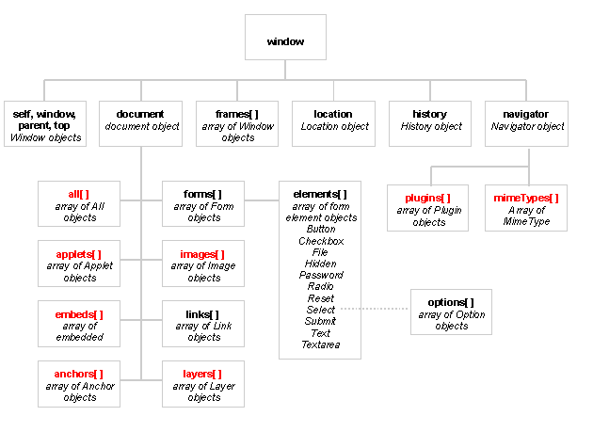
Object Hierarchy
Notes:
We will look at document and forms[] only in this session

Slide 29
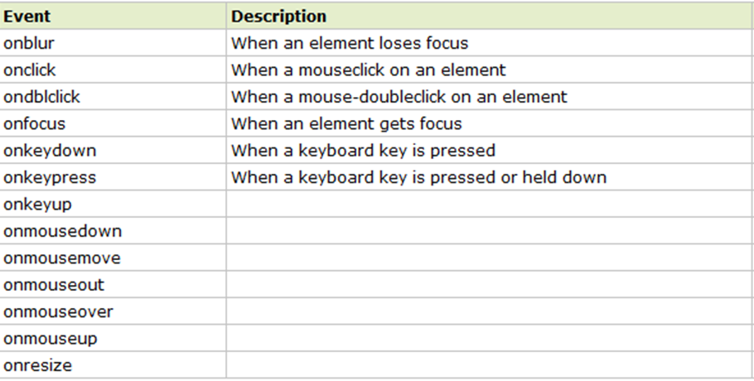
HTML elements object events

Slide 30
window object
window object is the highest level JavaScript object which corresponds to the web browser window.
window object contains document , location, frames and history object.
By default the window object is automatically available to the java script code written for the browser.
In other words alert() implicitly implies window.alert() and prompt() implicitly implies window.prompt()

Slide 31
Properties, events and methods
Properties
defaultStatus : default message that is loaded into the status bar when the window loads
closed : A boolean value that indicates whether the window is closed
length :No. of frames that the window contains
name :window name
self :current window
top : top most window
parent :parent window
opener :object that caused the window to open
status : to write a message in the status bar
Events
Methods
onError
onLoad
onscroll
onselectstart
onUnload
alert(displayString)
String prompt(question,defaultanswer)
boolean confirm(question)
+ HTMLElement
Object Events
Notes:
alert(displayString)
String prompt(question,defaultanswer)
If user clicks OK it returns the string entered by the user
If user clicks CANCEL it returns NULL
boolean confirm(question)
If user clicks OK it returns the true/1
If user clicks CANCEL it returns false/0

Slide 32
Example –status bar
<html><head>
<script>
function setStatus(x){
status=x;}
</script></head>
<body onLoad="defaultStatus='welcome'" onBlur="setStatus('OUT')" onFocus="setStatus('ON')“ >
Change the focus from in and out of the window and watch the message in the status bar
</body></html>
Note how script is written with the event
Notes:
This example displays welcome on the status bar when the page loads. When the focus is on the page it displays ON and when the focus moves out it displays OUT.

Slide 33
document object
Represents html document
Property of window object
Properties:
anchors[],forms[],images[],links[], title, cookie, domain, lastModified, referrer, URL
Methods:
write(), writeln(),getElementById() (where id is the attribute of the html elements), getElementsByName(), getElementsByTagName()
Events: HTMLElement Object Events

Slide 34
Example: document
The example displays the document title and URL in the page using document properties.
<html>
<title>document writing</title>
<body>
<pre>
<script type="text/javascript">
document.writeln("Title: "+ document.title);
document.writeln("URL:"+ document.URL);
</script>
</pre>
</body></html>
Please note that without <pre> tags the output of both writeln will be in same line when the HTML page is displayed. In other words, it writes HTML document content followed by a carriage return not <BR>!
Notes:
34

Slide 35
Exercise
Display a page with one input box asking user to enter a number. On losing focus from the input box, compute factorial of the number. Display the result in red in a fresh page When the user closes the window it says “Bye”.
(30 mins)
Hint: Use getElementsByTagName()and write() methods
Look at the reference document to know more.
Notes:
Getting an element:
document.getElementsByTagName(‘tag’)[index]
Example: to get to the p tag
document.getElementByTagName(‘p’)[0]
document is a predefined object available to JavaScript which indicates the current document
On any node following properties can be used to traverse
firstChild
lastChild
childNodes[index]
To get to the first node (that is <html>)
document.firstChild
To get the value of the node: nodeValue,to get the name of the node: nodeName

Slide 36
images
images[] is a property of document object representing array of window objects
Each array element represents an object of type Image
Properties:
align, alt, border, height, width, hspace,vspace, name, src
Events
Onabort
Onerror
Onload
+ HTMLElement Object Events

Slide 37
Example- Image rollover
This example changes the image you hover the mouse on the image
in the document
<html><head>
<title>Status</title>
<script>
function change(src)
{
document.images[0].src=src;
}
</script>
</head>
<body>
<img src="close.bmp" name=“eye” onMouseOver="change('open.bmp')" onMouseOut="change('close.bmp')">
</body>
</html>
Indicates the 1st image in the document
Or document.eye.src

Slide 38
forms
document object contains an array of form objects called forms.
Form object corresponding to the <form> tag.
Properties:
action, method, name, elements[], target
+ all the form elements listed in the hierarchy like button, checkbox etc.
Events:
onSubmit, onReset
Methods:
reset() - Used to reset the form elements to their default values.
submit() - Submits the form as though the submit button was clicked pressed by the user.

Slide 39
Form elements
Properties:
For all form elements → name, type, value (except select)
radio, checkbox: checked, defaultChecked
select: length, options[], selectedIndex
text, password, textarea:defaultValue
Methods:
All form elements: focus(), blur()
For button, submit, reset: click()

Slide 40
Events
For all form elements→ onBlur, onFocus
For select, text, textarea→ onChange
For text, textarea→ onSelect
For button,submit,reset,radio,checkbox: onClick
For button: onMouseDown, onMouseUp,
For textArea: onKeyDown, onKeyUp,onKeyPress

Slide 41
Ways to get form field values
<form>
<input type="text" name="name" id=“n1“>
</form>
Getting the value using elements array:
document.forms[0].elements["name"].value;
document.forms[0].elements[0].value;
document.forms[0].elements[“n1”].value;
Using form name and element name/id combination:
document.[forms[0]/f1].[login/n1].value

Slide 42
Example: form components
This example uses text fields , radio button and checkbox.
<html><head><title>Validate</title>
<script>
function check(){
with(document.forms[0]){
if ((name.value=="") || (address.value=="")) {
alert("Please ensure that all fields are filled up"); return false;
}
s=like[0].checked?like[0].value:like[1].value;
s="Thankyou,"+name.value+". You "+ s +" our site.\n";
s=s+"Your suggesstion (";
Instead of name attribute of the text field, id attribute can also be used if provided

Slide 43
for(i=0;i<better.length;i++)
if (better[i].checked) s=s+ better[i].value+";"
s=s+" ) are recorded “; }
alert(s);
return true;}
</script>
</head><body>
<form action="thank.html" onSubmit="return check()">
Name: <input type=text name=“name”><br><br>
Address: <input type=text name=“address”><br><br>
Do you like our site
<input type=radio name="like" value="like" checked>Yes
<input type=radio name="like" value="don't like">No <br><br>
When check() returns false, the form does not get submitted→ the page does not go to thank.html

Slide 44
Tell us how we can make this site better for you:<br>
<input type=checkbox name="better" value="Change the bg color">Change the bg color
<br>
<input type=checkbox name="better" value="Change the fg color">Change the fg color
<br>
<input type=checkbox name="better" value="Change the layout">Change the layout
<br>
<input type=checkbox name="better" value="Include more services">Include more services
<br><br><input type=submit></form> </body></html>

Slide 45
Example : working with select
The page displays a multiple choice question. A dialog box pops up depending on the radio button chosen by the user.
<html><head>
<title>Validate</title>
<script>
function check(){
i=document.f1.choose.options.selectedIndex;
if(i==0)
alert("Correct");
else
alert("Your choice, "+ document.f1.choose.options[i].text +"- is incorrect");
}
</script>
</head>
<body>

Slide 46
<form name=f1>
Which of the following is not true about JavaScript?
<select name="choose" onChange="check()">
<option>JavaScript is object-oriented language</option>
<option>JavaScript is loosely typed language</option>
<option>JavaScript is used for client side validations</option>
<option>JavaScript is platform independent</option>
</select></form>
</body></html>

Slide 47
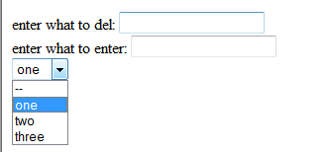
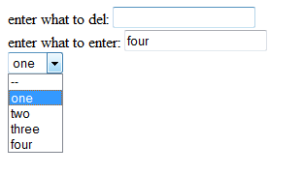
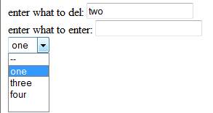
Example: adding Option element dynamically
This example adds or deletes Choice box options based on what user enters
On opening the document
onBlur
onBlur

Slide 48
<html><head>
<script type="text/javascript">
function remSelOpt(inp1, sel1) {
len1 = sel1.options.length;
for (i=0;i<len1 ;i++ ) {
if (sel1.options[i].value == inp1.value) {
sel1.options[i] = null;
break;
}
}
}
function addSelOpt(inp1, sel1) {
len1 = sel1.options.length;
option0 = new Option(inp1.value,inp1.value);
sel1.options[len1]=option0;
}
</script>
</head>

Slide 49
<body><form>
enter what to del:
<input type=text name="removeOption" onblur="remSelOpt(this,this.form.selectList)">
<br>
enter what to enter:
<input type=text name="removeOption" onblur="addSelOpt(this,this.form.selectList)">
<br>
<select id="selectList" name="selectList">
<option value="--">--</option>
<option value="one" selected="selected">one</option>
<option value="two">two</option>
<option value="three">three</option>
</select>
</form>
</body></html>

Slide 50
Exercise
In the web page that you created for a software company, there is a user registration form which will get the users details. On click of the submit button, validate the fields like Name, Date of birth, Email id, Phone no. And on clicking the reset button, clear the form.
(45 mins)

Slide 51
Cookie
Cookie is small piece of textual information sent by the server to the browser client. It is stored on the client’s machine, and returned by the client’s machine with each request made to the server.
Web server sends cookies by sending the Set-Cookie response header.
Cookies maintain information between more than one browser session.

Slide 52
Components of a cookie
name= value
comment= cmt
domain= domainName
expires = date
path= path
Set-Cookie: uid=732423sdfs73242; expires=Fri, 31-Dec-2010 23:59:59 GMT; path=/; domain=.example.net

Slide 53
Example-cookie
<html><head>
<script>
function setCookie(value){
var dt=new Date();
dt.setDate(dt.getDate()+1);
document.cookie="uname=" +escape(value)+"; expires="+dt.toGMTString(); }
function checkCookie(){
username=getCookie('uname');
if (username!=null && username!="") {
document.forms[0].uname.value=username;
}}
Notes:
This example displays a textbox which is empty first time it is viewed.
After the name has been entered in the textbox and the button is clicked, the cookie is set.
Next time when the file is opened, the textbox has the name already set from the cookies.

Slide 54
Activity
//Write the function getCookie() the
</script></head>
<body onLoad="checkCookie()">
<form>Name:<input type="text" name="uname">
<input type="button" value="set" onClick="setCookie(document.forms[0].uname.value)">
</form></body></html>
Notes:
function getCookie(name){
if (document.cookie.length>0) {
ind=document.cookie.indexOf(name);
if (ind!=-1) {
ind=ind+name.length+1 ;
ind1=document.cookie.indexOf(";",ind);
if (ind1==-1) ind1=document.cookie.length;
return unescape(document.cookie.substring(ind,ind1));
}
}
return "“;}

Slide 55
Summary
JavaScript is a scripting language developed by Netscape, and later standardized by W3C. JavaScript can read an external XML file and update the data content of your web page.
Data types like integer, floating point, String, Boolean are supported.
A function can be defined inside <head> , <body> or in an external file and can be called from anywhere after it has been read.
window object is the highest level JavaScript object which corresponds to the web browser window.
document object Represents html document.
images[] is a property of document object representing array of window objects.
document object contains an array of form objects called forms.

